Slide 1
Nitrate Leaching in Southland Aquifers
Anton Aish, Jenny Choi, William Laughton, Annie Li, Sidharth Varma

Slide 2
Why?
Increase in nitrate leaching into Southland aquifers due to dairy farming
harmful in drinking water, especially to small children
negative environmental ramifications
economic issue - reliance on dairy farming in the region
Stakeholders
Southland dairy farmers
The local iwi
Southland Regional Council (Environment Southland)
Southland Residents
Fonterra

Slide 3
How?
Model will focus on nitrate concentration in the Edendale aquifer
Quantify effects of active carbon sink installed in 2010
Will also provide insight regarding the design of the proposed MAR program
The insights gained from these two programs could help with the decision making process for Southland Regional Council for all the farms in the region that contribute to nitrate leaching

Slide 4
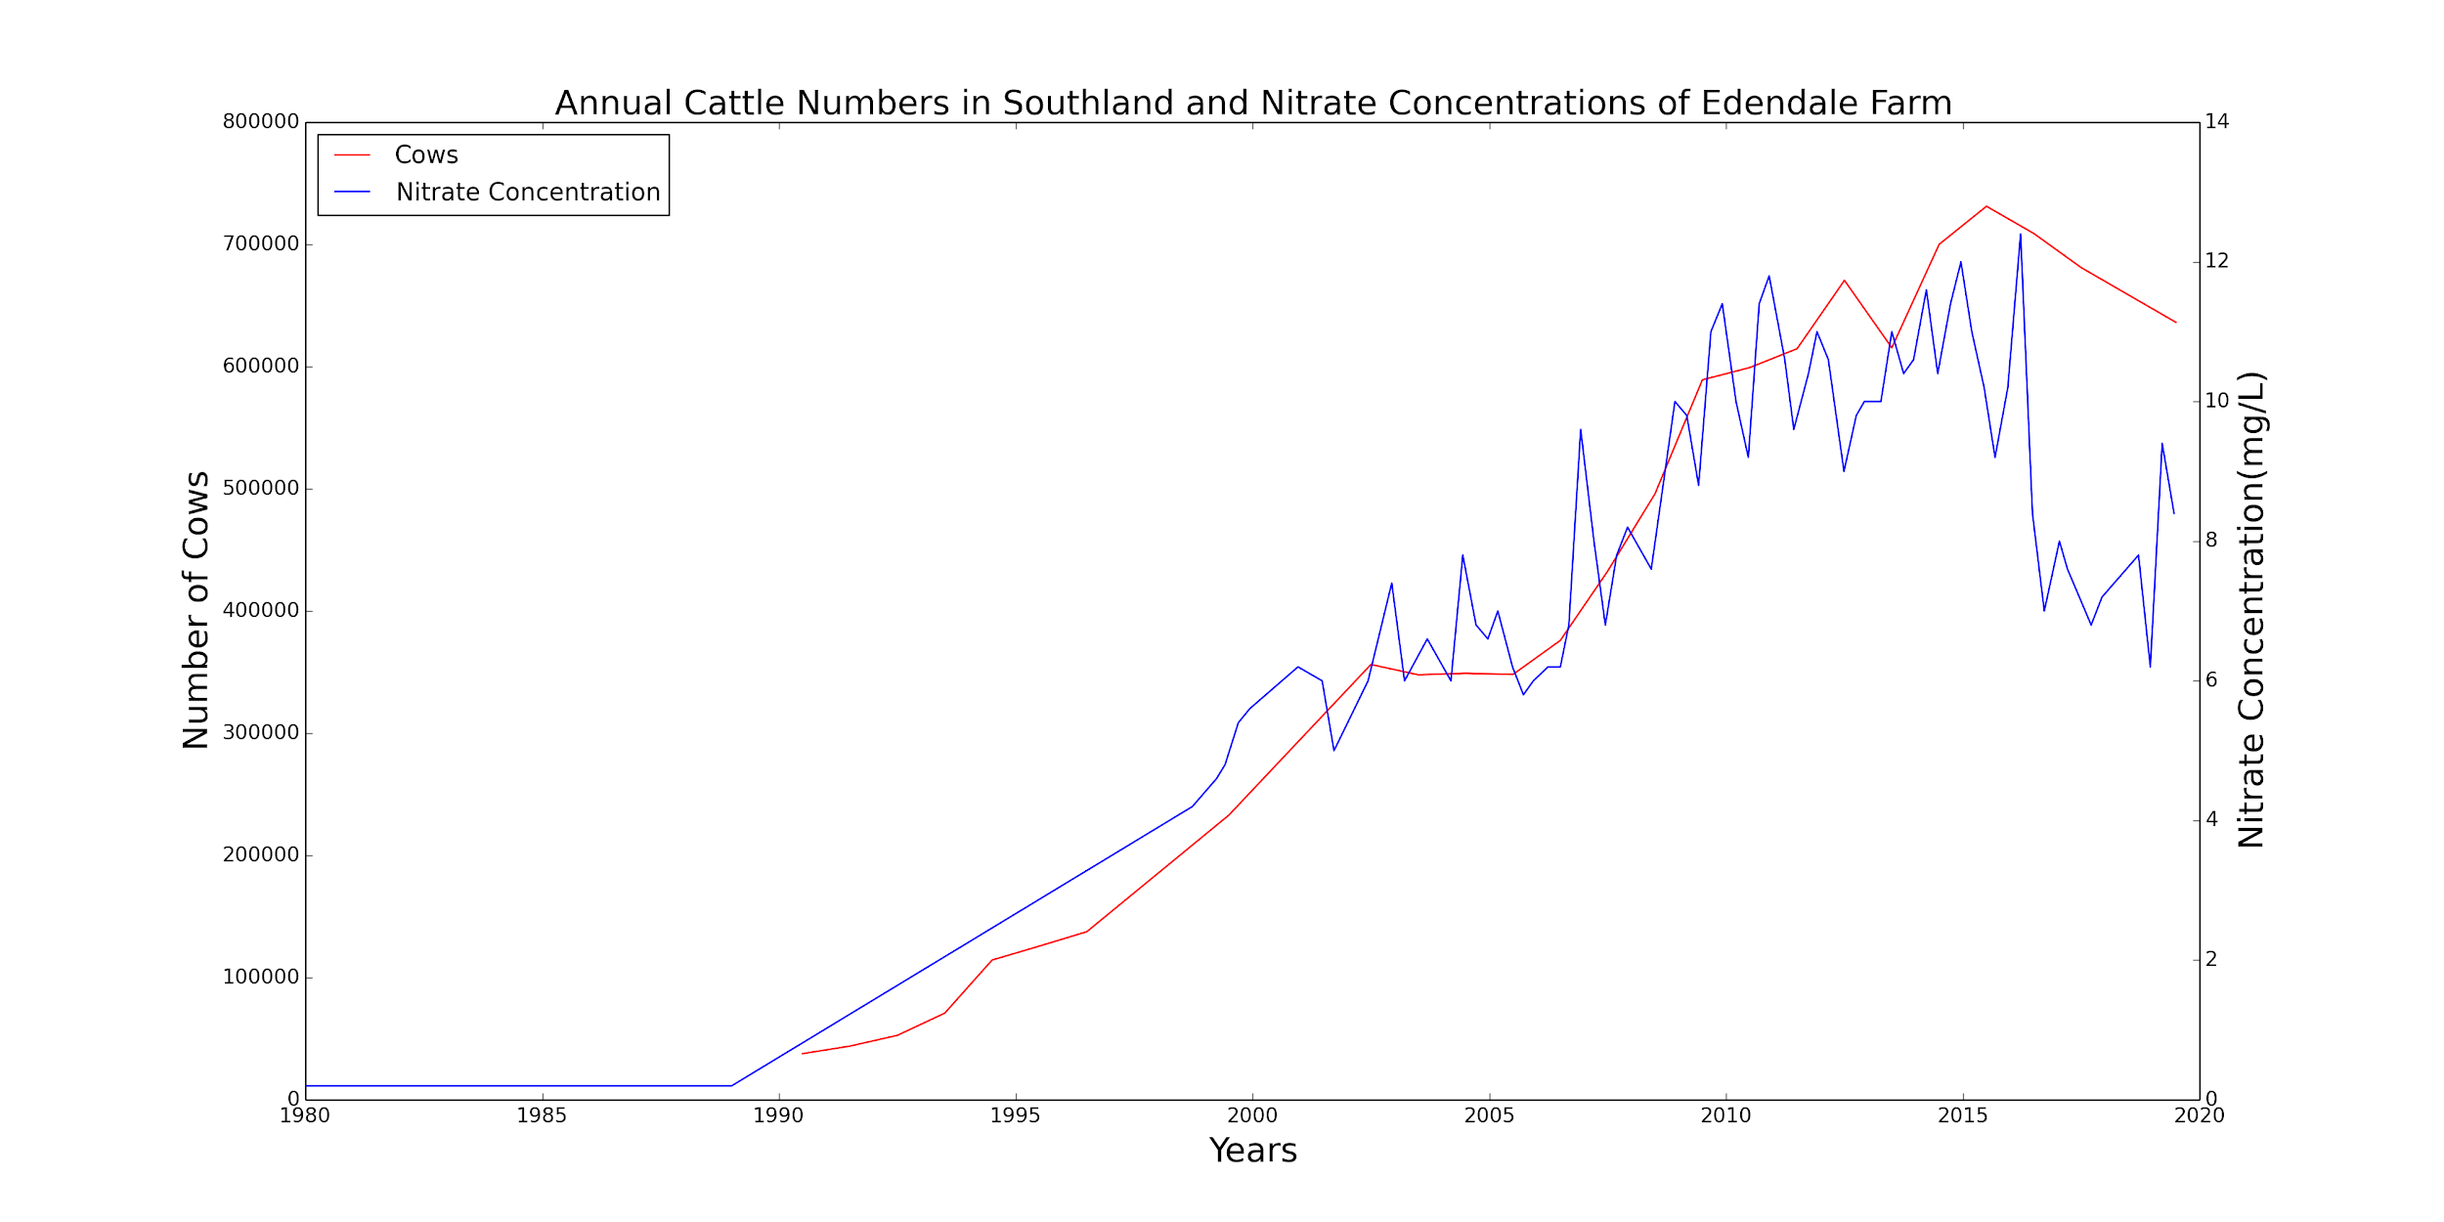
Given?
Clear correlation between number of cows and nitrate concentration.
Increase in nitrate concentration in the 1990’s due to increase in cattle farming.
Gap in data between 1989 and 1998. More frequent observations after 1998.

Slide 5
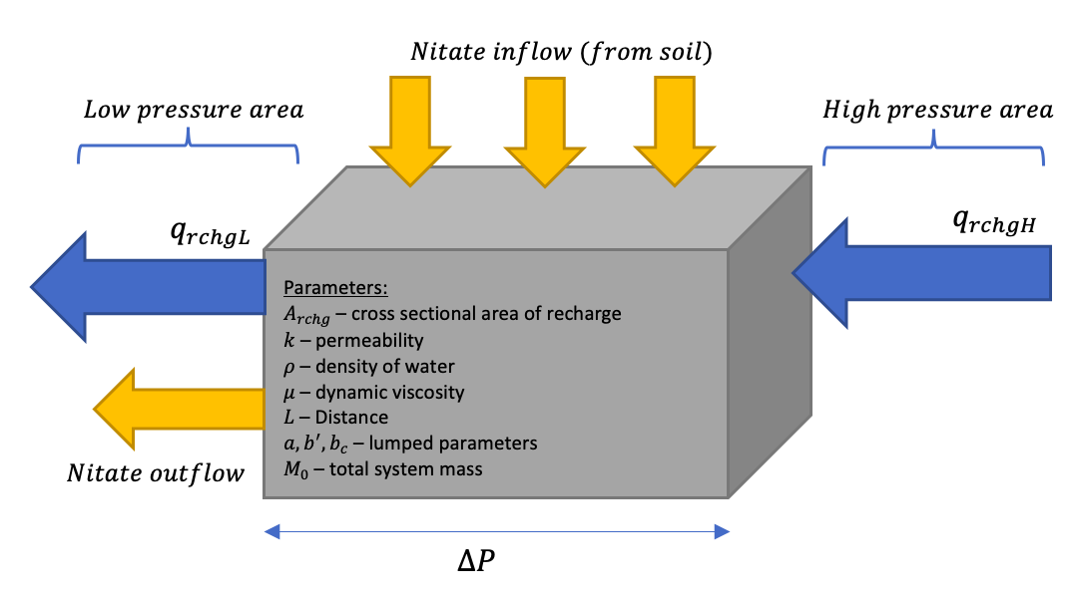
Assume?
Important physical processes
Fluid mechanics
Chemical transport
Lag time
Assumptions
Isothermal system
Average pressure within CV
Average Nitrate conc in CV
Water mass flux (soil) = 0
Total system mass constant

Slide 6
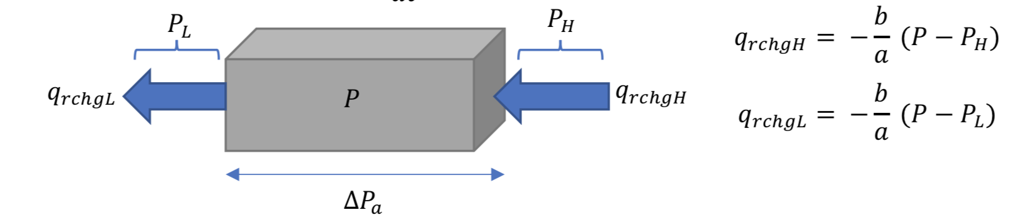
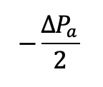

Formulate?

Slide 7
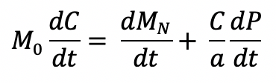
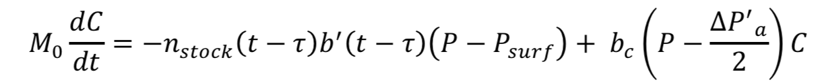
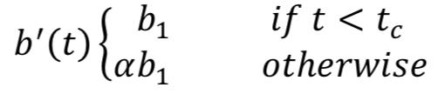
Formulate

Slide 8
Working?
We implemented unit tests for the edge cases of our functions
We used convergence test to find the most suitable step size for solving our model
We compared the numerical solution with the analytical benchmark solution (see next slides)

Slide 9
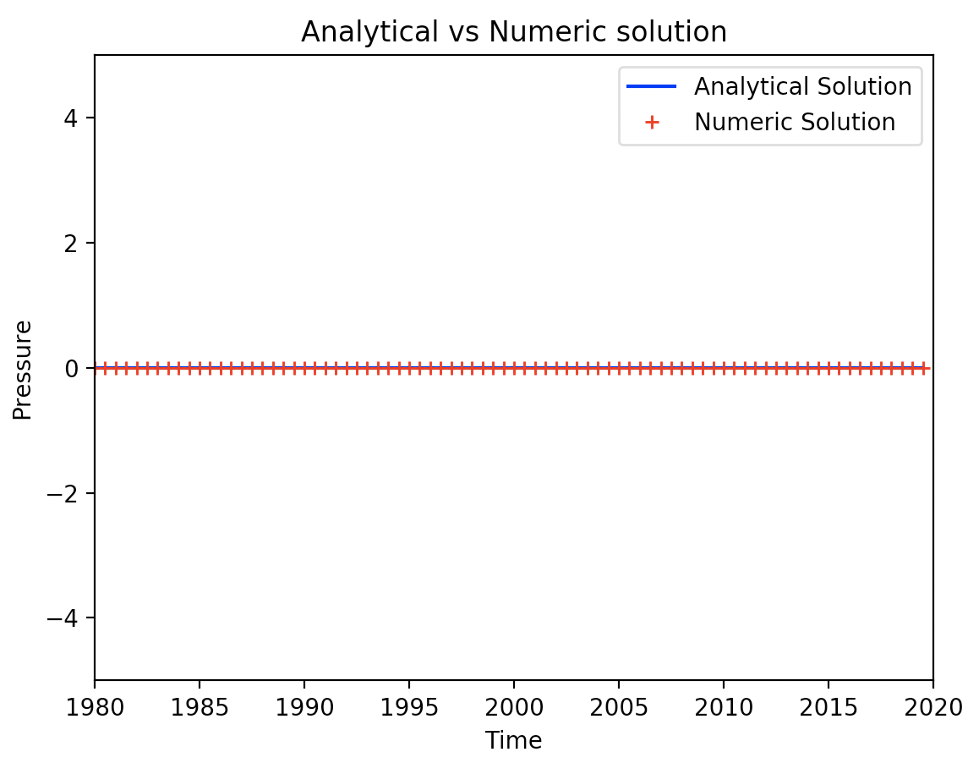
Working?
Analytical Solution: P(t) = C1e^(-2t) where C1 = 0

Slide 10
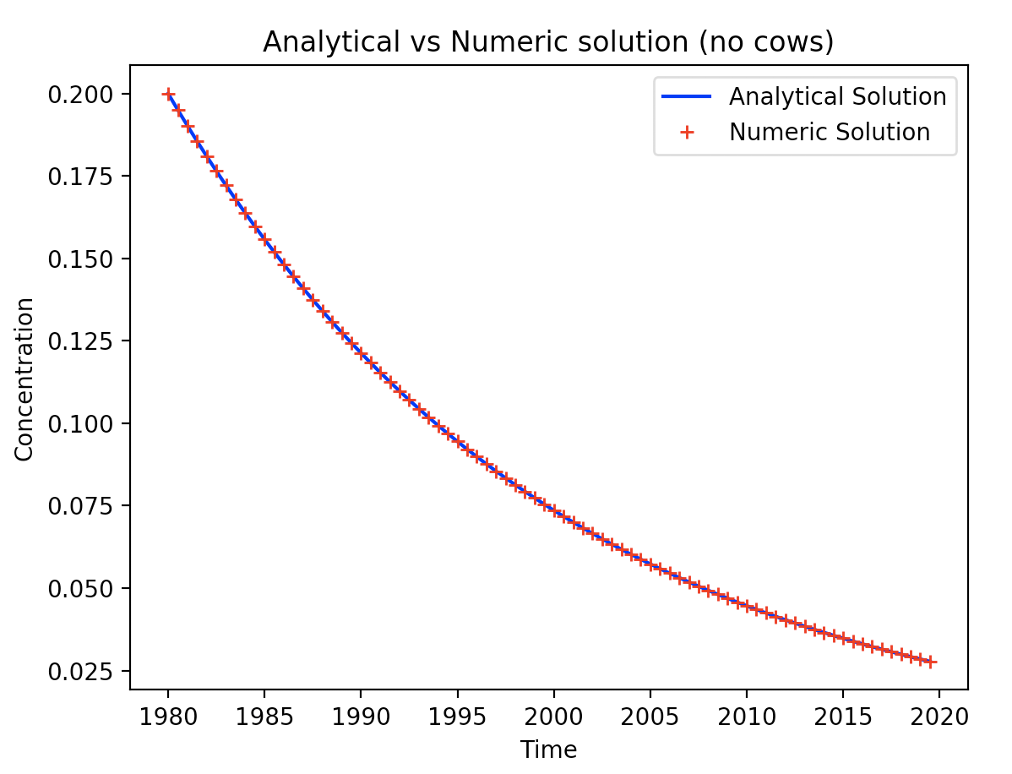
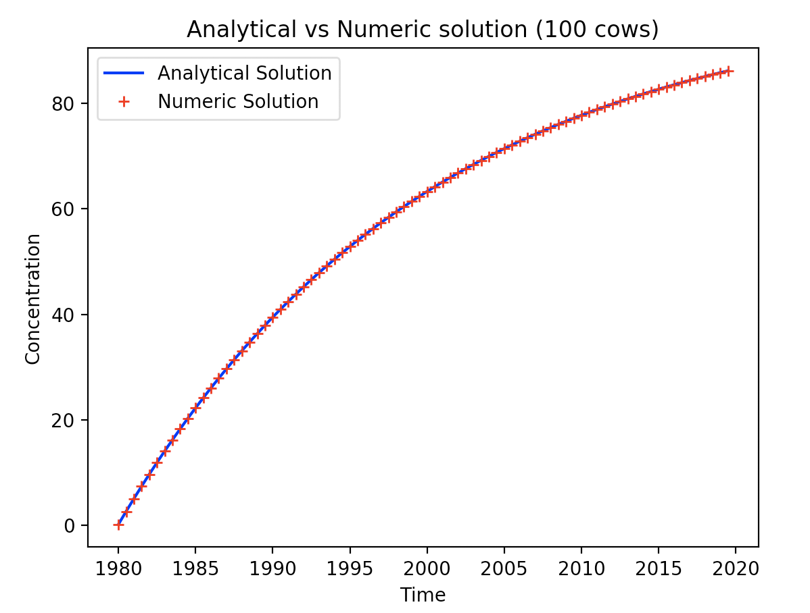
Working?
Analytical Solution: C(t) = 0.2e^(-0.05t + 99)
Analytical Solution: C(t) = -(499/5)e^(-t+1980/20) + 100

Slide 11
Suitable?
• Calibrate the model parameters, by manual or automatic means, to the experimental or other source of data.
• Quantify the misfit between model and data. Speculate on the source of this misfit.

Slide 12
Improve?
We decided to only calibrate for when there is data for both cows and nitrate concentration from 1999

Slide 13
Use?
• Formulate and solve an inverse problem, using a model and some data to determine an unknown parameter.
• Formulate and solve a forward problem, calibrating a model to data and extrapolating its behaviour into the future.
• Define a representative set of model scenarios that capture a diversity of possible system configurations. Run simulations for each and summarise the diversity of future outcomes.

Slide 14
Unknown?
• Describe the prior distribution of an unknown parameter and infer a posterior distribution by calibrating the model to data.
• Sample over parameter uncertainty to construct many models and an interval of predictions.
• Rank potential sources of structural error in the model in terms of their impact on model insights

Slide 15
Recommend?
• Fairly represent the outcomes of what-if scenarios in simple terms.
• Describe a model forecast of the future, mentioning the period of the forecast, the conditions under which it is valid, and the inherent uncertainty.
• Describe a model parameter inversion, including the conditions under which the inversion is valid.
• Suggest an appropriate course of action given the model results and the goals of the stakeholders.

